Slide 1
Creating a Serverless Image Thumbnail Generator with AWS Lambda Functions
By Dyotana Acharyya

Slide 2
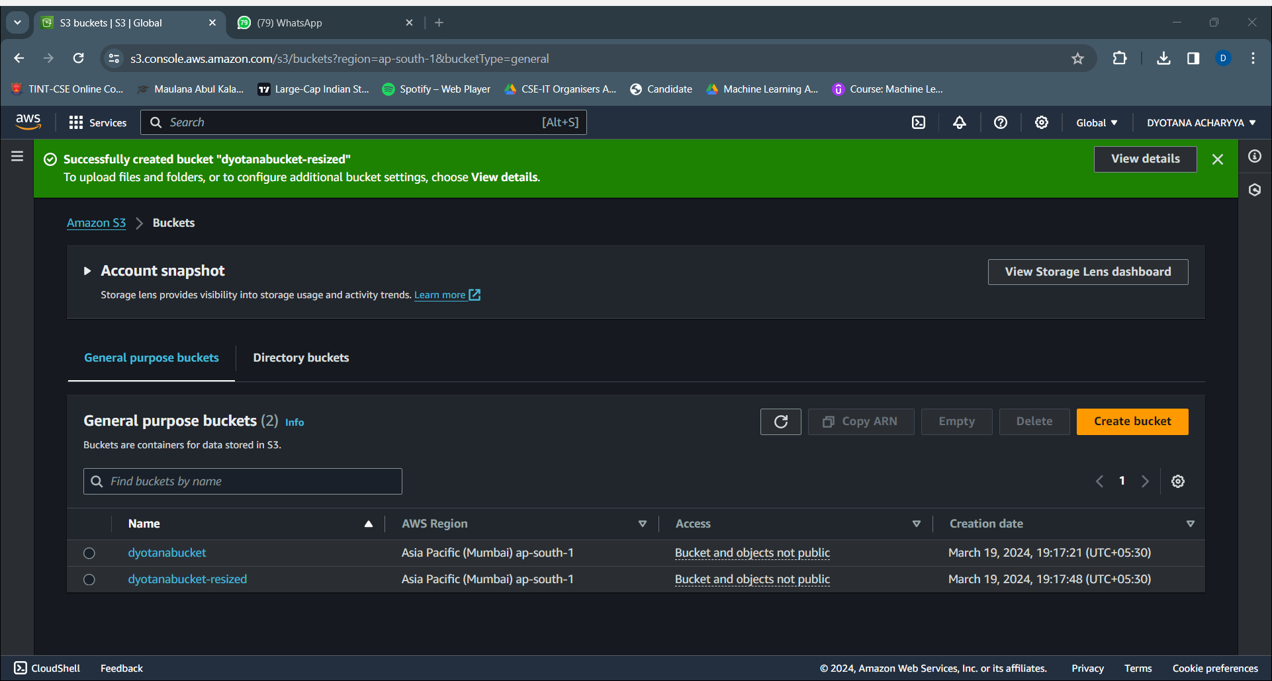
Steps to be followed include-
1. Create two S3 buckets, source bucket for storing the original image (dyotanabucket) and the other destination bucket for storing the thumbnail image (dyotanabucket-resized).

Slide 3
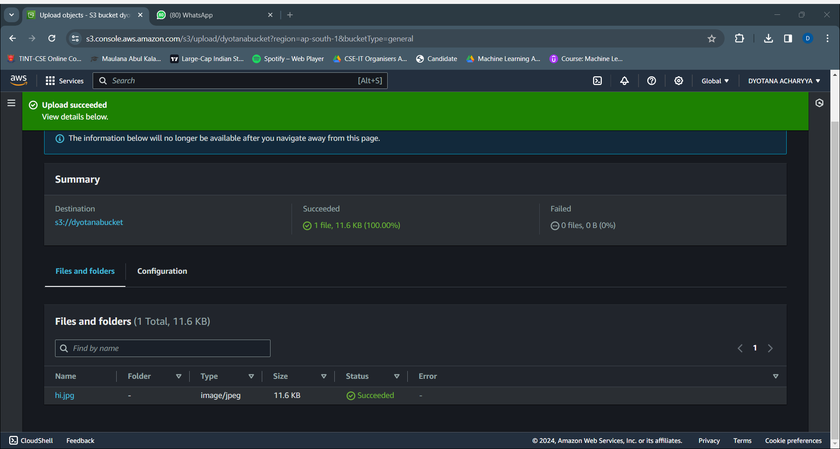
2. Upload a test image (hi.jpeg) in the source bucket to test the Lambda function later.

Slide 4
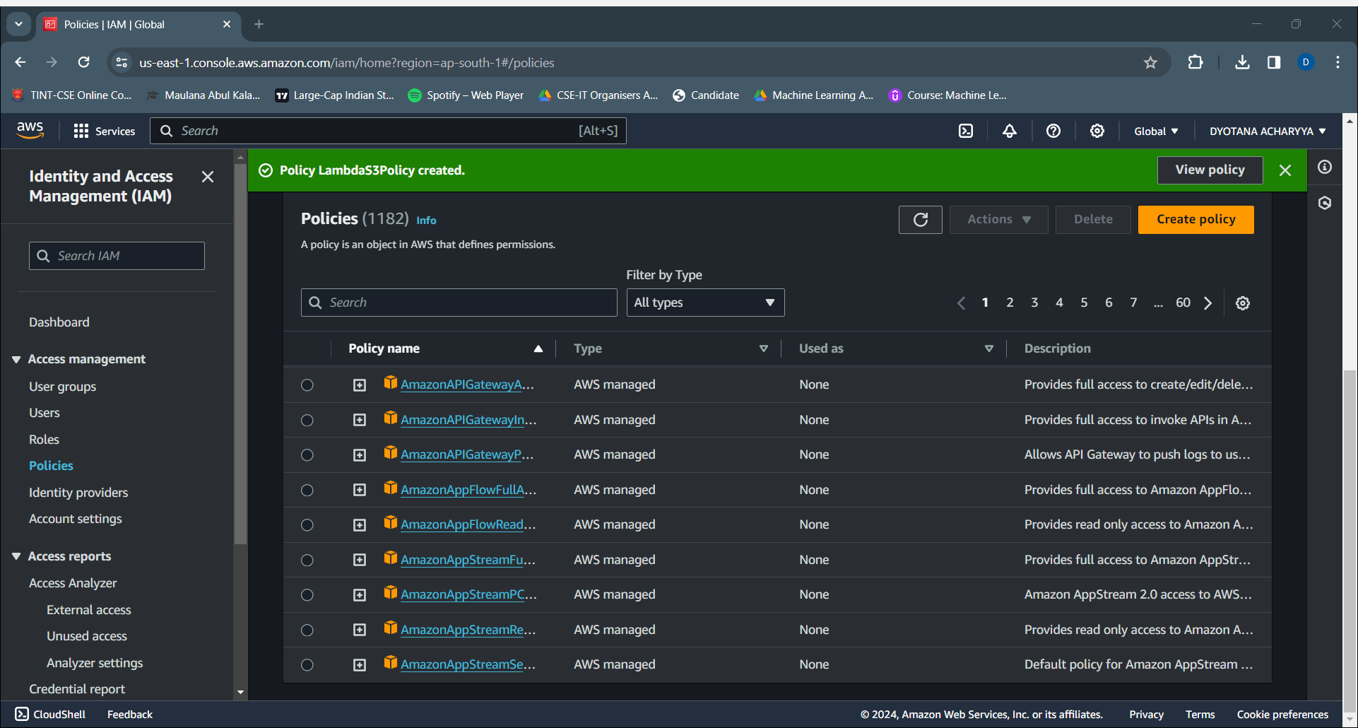
3. IAM > Policies > Create Policy to create a LambdaS3Policy.

Slide 5
The following JSON code is to be used while creating the policy-
{
"Version": "2012-10-17",
"Statement": [
{
"Effect": "Allow",
"Action": [
"logs:PutLogEvents",
"logs:CreateLogGroup",
"logs:CreateLogStream"
],
"Resource": "arn:aws:logs:*:*:*"
},
{
"Effect": "Allow",
"Action": [
"s3:GetObject"
],
"Resource": "arn:aws:s3:::*/*"
},
{
"Effect": "Allow",
"Action": [
"s3:PutObject"
],
"Resource": "arn:aws:s3:::*/*"
}
]
}

Slide 6
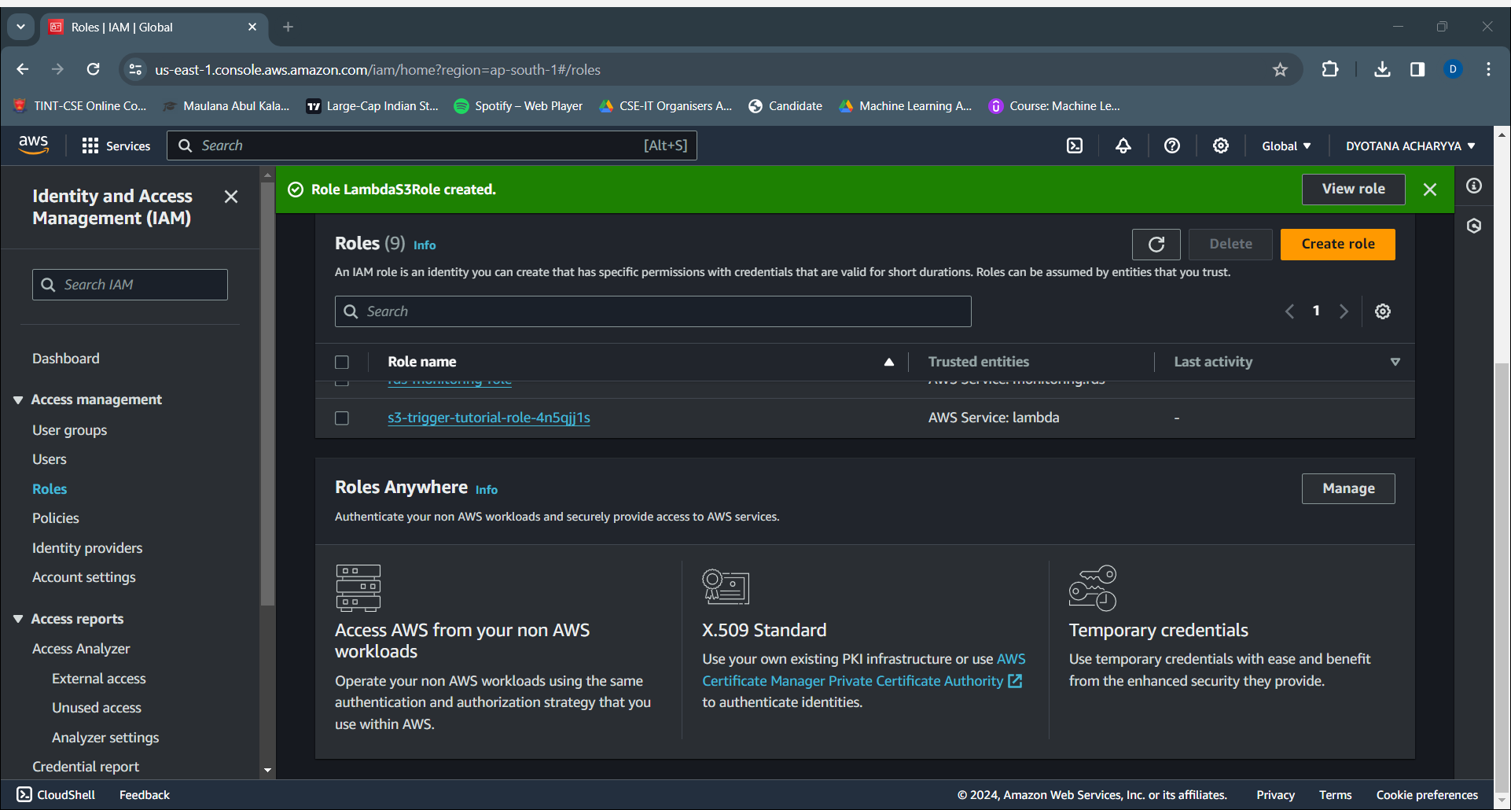
4. Create an execution role named LambdaS3Role from IAM > Roles >Create role under policy name LambdaS3Policy.

Slide 7
5. Open CloudShell.
Make a directory named lambda-s3 using mkdir lambda-s3 followed by cd lambda-s3 to enter into the directory.
Open a file named index.mjs and edit it using the code-
// dependencies
import { S3Client, GetObjectCommand, PutObjectCommand } from '@aws-sdk/client-s3';
import { Readable } from 'stream';
import sharp from 'sharp';
import util from 'util';
// create S3 client
const s3 = new S3Client({region: 'us-west-2'});
// define the handler function
export const handler = async (event, context) => {
// Read options from the event parameter and get the source bucket
console.log("Reading options from event:\n", util.inspect(event, {depth: 5}));
const srcBucket = event.Records[0].s3.bucket.name;
// Object key may have spaces or unicode non-ASCII characters
const srcKey = decodeURIComponent(event.Records[0].s3.object.key.replace(/\+/g, " "));
const dstBucket = srcBucket + "-resized";
const dstKey = "resized-" + srcKey;
// Infer the image type from the file suffix
const typeMatch = srcKey.match(/\.([^.]*)$/);
if (!typeMatch) {
console.log("Could not determine the image type.");
return;
}

Slide 8
// Check that the image type is supported
const imageType = typeMatch[1].toLowerCase();
if (imageType != "jpg" && imageType != "png") {
console.log(`Unsupported image type: ${imageType}`);
return;
}
// Get the image from the source bucket. GetObjectCommand returns a stream.
try {
const params = {
Bucket: srcBucket,
Key: srcKey
};
var response = await s3.send(new GetObjectCommand(params));
var stream = response.Body;
// Convert stream to buffer to pass to sharp resize function.
if (stream instanceof Readable) {
var content_buffer = Buffer.concat(await stream.toArray());
} else {
throw new Error('Unknown object stream type');
}
} catch (error) {
console.log(error);
return;
}
// set thumbnail width. Resize will set the height automatically to maintain aspect ratio.
const width = 200;

Slide 9
// Use the sharp module to resize the image and save in a buffer.
try {
var output_buffer = await sharp(content_buffer).resize(width).toBuffer();
} catch (error) {
console.log(error);
return;
}
// Upload the thumbnail image to the destination bucket
try {
const destparams = {
Bucket: dstBucket,
Key: dstKey,
Body: output_buffer,
ContentType: "image"
};
const putResult = await s3.send(new PutObjectCommand(destparams));
} catch (error) {
console.log(error);
return;
}
console.log('Successfully resized ' + srcBucket + '/' + srcKey +
' and uploaded to ' + dstBucket + '/' + dstKey);
};

Slide 10
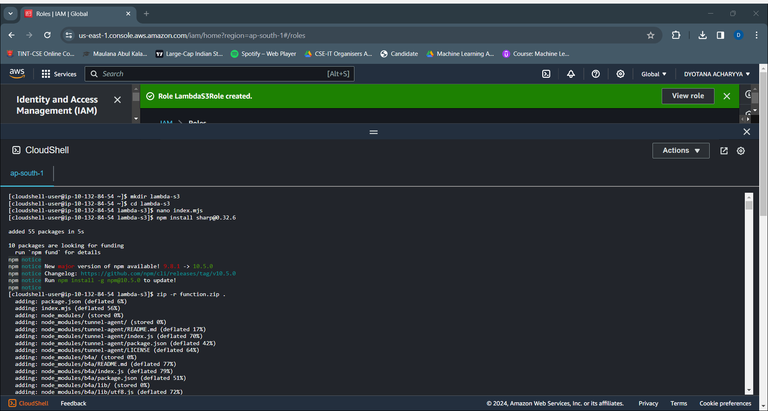
npm install sharp@0.32.6
zip –r function.zip . to create a zip file containing my code and all the required modules.
Download the zip file in your local machine.

Slide 11
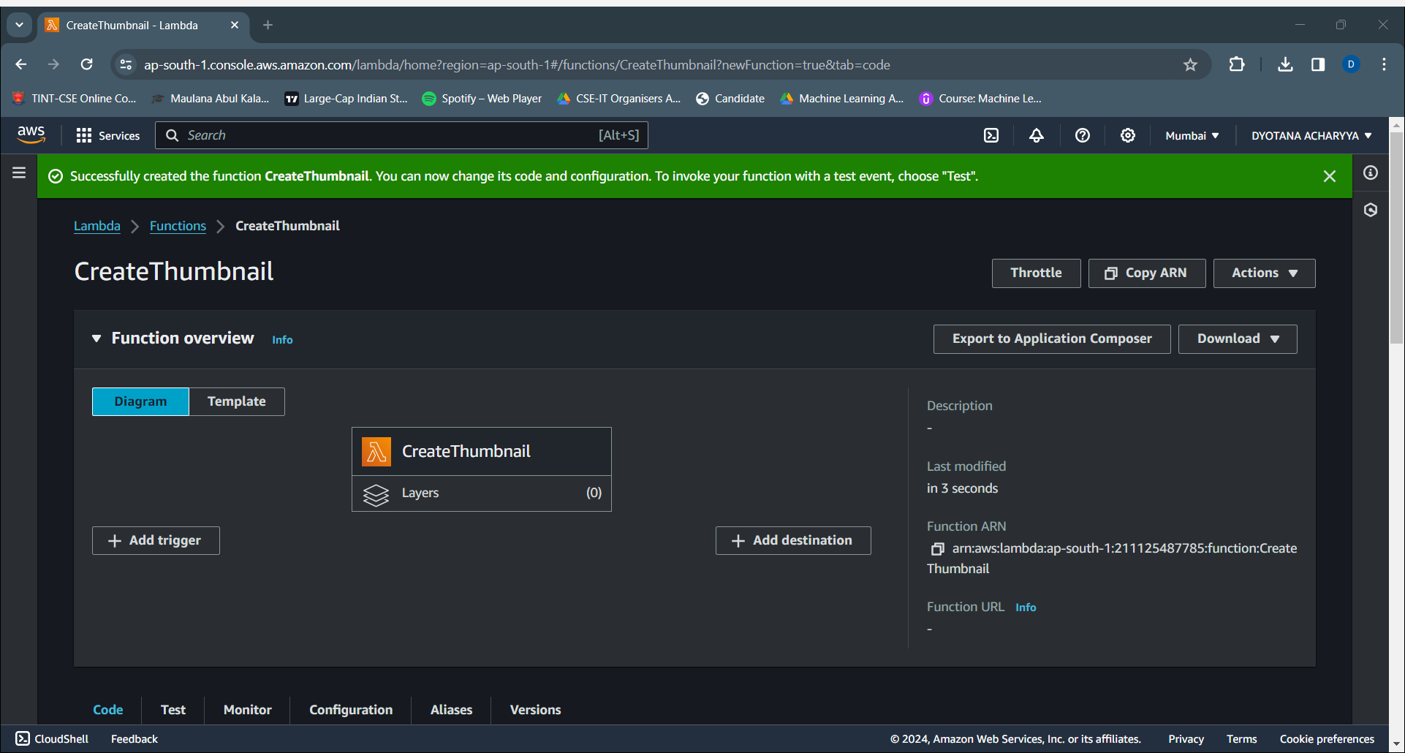
6. Create a Lambda function named CreateThumbnail in the same region as your S3 buckets, of Node.js 18.x using the existing role LambdaS3Role. Upload the previously downloaded function.zip in this Lambda function.

Slide 12
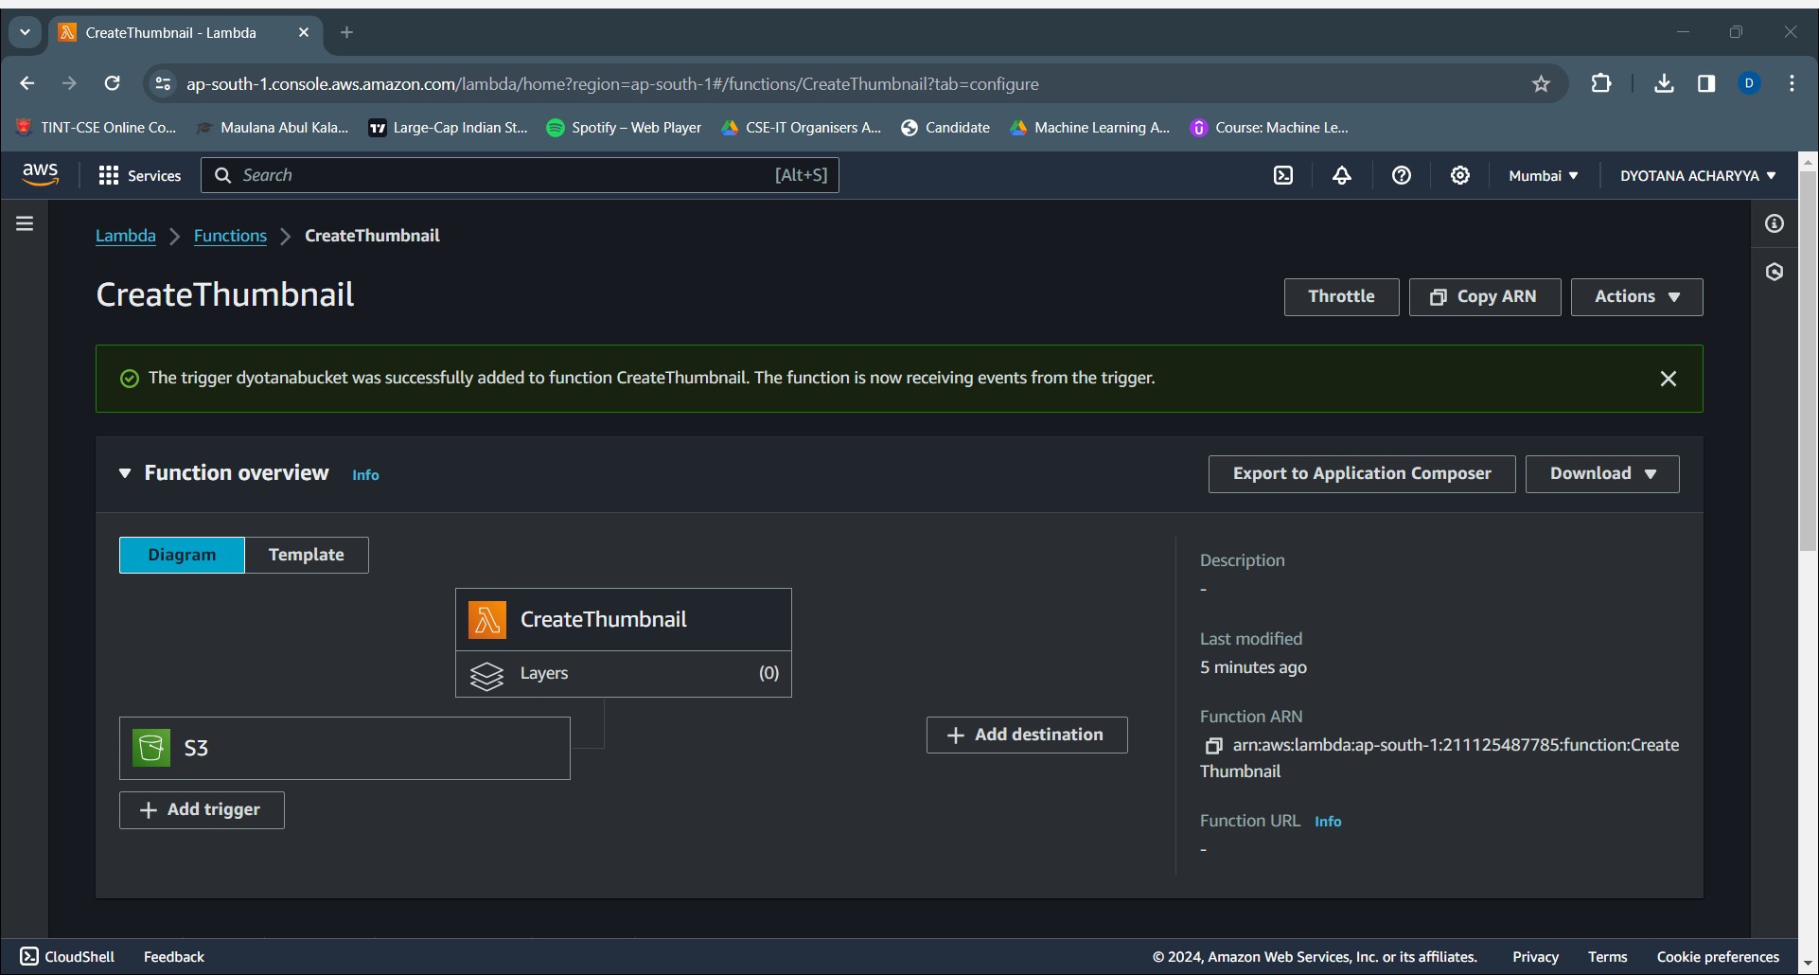
7. Now we add a trigger to the Lambda function. We associate it with the source S3 bucket (dyotanabucket).

Slide 13
8. Now we create a dummy event named myTestEvent to check my Lambda function. We use the code-
{ "Records": [ { "eventVersion": "2.0", "eventSource": "aws:s3", "awsRegion": "ap-south-1", "eventTime": "1970-01-01T00:00:00.000Z", "eventName": "ObjectCreated:Put", "userIdentity": { "principalId": "EXAMPLE" }, "requestParameters": { "sourceIPAddress": "127.0.0.1" }, "responseElements": { "x-amz-request-id": "EXAMPLE123456789", "x-amz-id-2": "EXAMPLE123/5678abcdefghijklambdaisawesome/mnopqrstuvwxyzABCDEFGH" }, "s3": { "s3SchemaVersion": "1.0", "configurationId": "testConfigRule", "bucket": { "name": "dyotanabucket", "ownerIdentity": { "principalId": "EXAMPLE" }, "arn": "arn:aws:s3:::example-bucket" }, "object": { "key": "hi.jpg", "size": 1024, "eTag": "0123456789abcdef0123456789abcdef", "sequencer": "0A1B2C3D4E5F678901" } } } ]}
We save it and test this event.
We open the destination S3 bucket and find the thumbnail of the image uploaded in the source bucket.

Slide 14
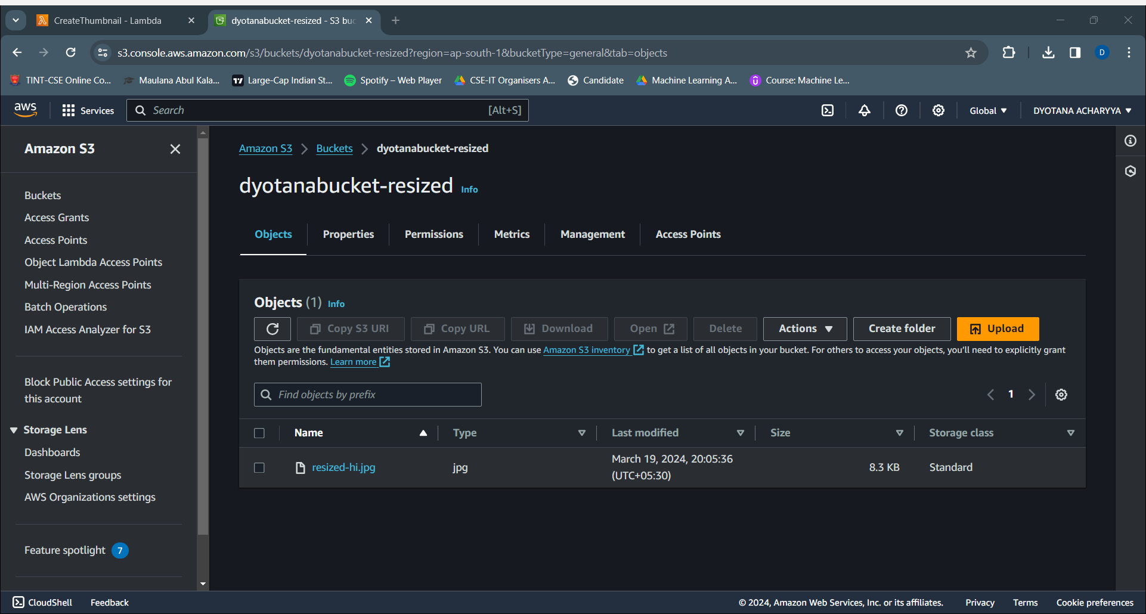

Slide 15
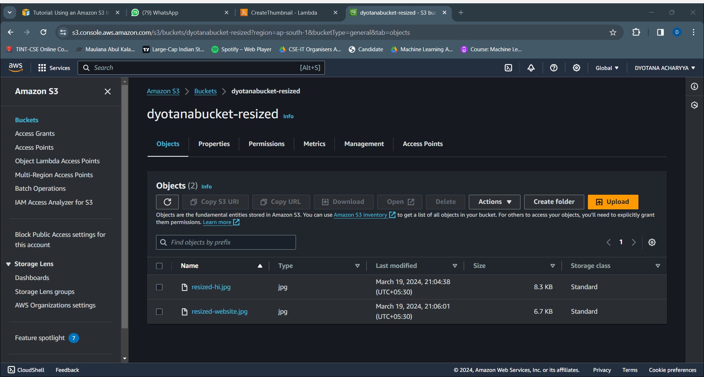
9. The trigger works fine as we have found a thumbnail image for the image that has been uploaded in the source bucket.

Slide 16
10. Delete the function CreateThumbnail from the Lambda.
11. Delete the policy LambdaS3Policy from IAM > Policies.
12. Delete the role LambdaS3Role from IAM > Roles.
13. Empty the two buckets and delete them.

Slide 17
THANK YOU

